Slide 1
MINI PROJECT
GROUP 10

Slide 2

CONCEPT

Slide 3
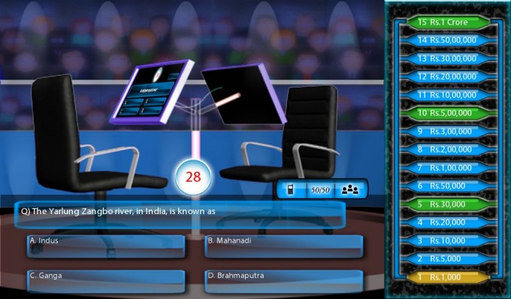
SEVERAL RULES

Slide 4
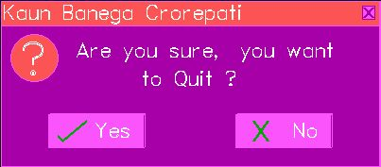
SEVERAL CONDITION

Slide 5
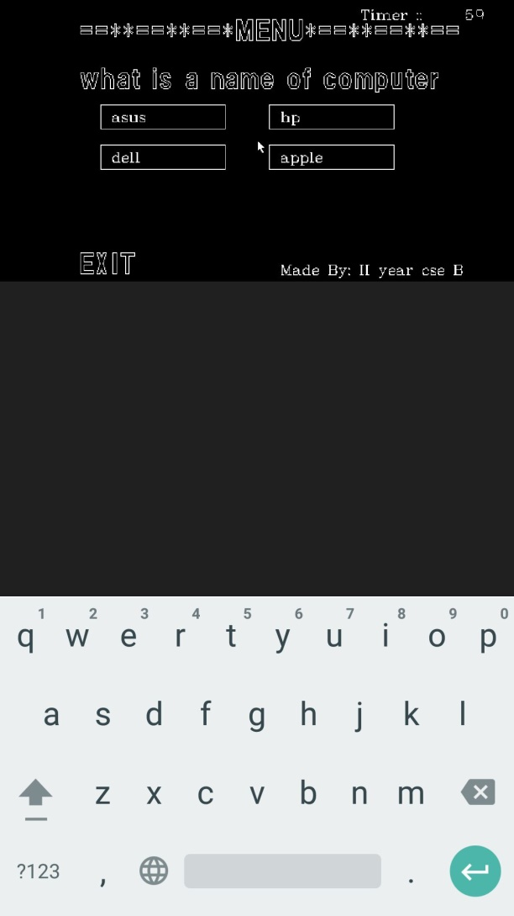
DEMO OUTPUT

Slide 6
THANK YOU!
By
Team 10
Karthik.G
Kaviraj.S
KrishnaMoorthy.M
Priyanka.R

